Slide 1


Cardiac Arrest Prediction
using PySpark
Sankalpa Saha

Slide 2
Problem Statement
Sudden cardiac death (SCD) is a major global health problem, accounting for up to 20% of deaths in Western societies including India. Work life stress, lifestyle, hypertension, health ignorance is causing cardiac arrest even in age group lower than 20 years. Cardiac arrest is responsible for half of the cardiac disease related death.
This project revolves around devicing ml techniques using Pyspark to predict the probability of having a cardiac arrest by taking certain attributes in consideration.

Slide 3

Objective
The objective is to predict whether a person will have cardiac arrest or not based on certain attributes like demographics, health conditions etc.
Spark and machine learning will be used to find the optimum model to predict occurrence of cardiac arrest precisely so that prior measures can be taken to prevent it.

Slide 4
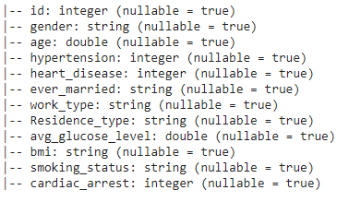
Understanding
Data
Features/Attributes
ID-Patient ID
Gender
Age
Hypertension
Heart disease
Job type
Residence type
Blood sugar level
Body mass index
Smoking status
Target
Cardiac arrest- ‘Yes’-0 ‘No’-1

Slide 5

Exploratory Data Analysis
The data is heavily skewed towards a chance of not having a cardiac arrest(cardiac_arrest ==0) which can lead to inaccurate model implementation.
There lies a chance of classifying people having chance of cardiac arrest to be flagged as healthy which is dangerous for them as well as for the company implementing ml model with such data samples. We will try to balance data afterwards.

Slide 6
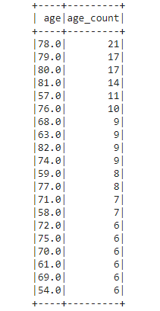
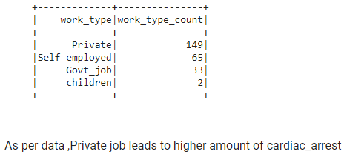
EDA (continued)
Agewise cardiac arrest risk. Can be concluded people in age bracket 60-80 have higher risk

Slide 7
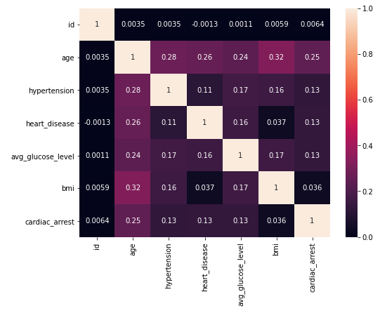
EDA (continued)
Visualisation of correlation among the features and target using heatmap. It is observed that the individual features have very weak correlation among them.

Slide 8
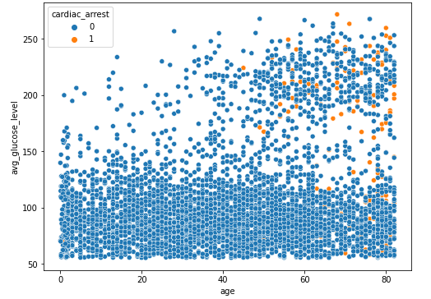
EDA (continued)
Though very scarce datapoint for having cardiac arrest(orange indicated) are present in the dataset ,from the swarmplot it is evident that cardiac arrest has occurred in people having high sugar level in the age of 50-80 years

Slide 9
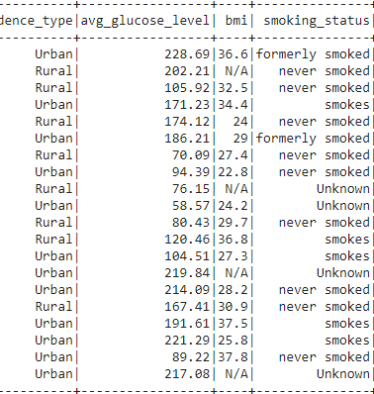
Data Preprocessing
Data had ‘N/A’ values in ‘bmi’ column which needed to be imputed. We had imputed the values with mean value of bmi.
It is also seen that certain feature column has categorical data in form of string which we need to process with StringIndexer which will convert the categorical data into labels.
But StringIndexer is a label encoding technique which may capture relationship/popularity or rank of categorical data. So we will also use OneHotEncoder which creates dummy variable to improve model accuracy and remove the multicollinearity.
Vector assembler is also a important technique in Spark to combine the raw features and features generated from various transforms into a single feature vector. It will always feature in pyspark ml workflow when we have to combine all your features before training.

Slide 10
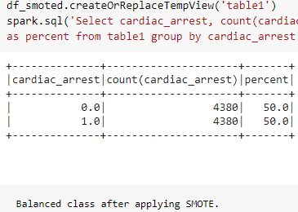
Data Imbalance Handling
Imbalanced classification involves developing predictive models on classification datasets that have a severe class imbalance.
For imbalanced datasets, most machine learning techniques will ignore, and in turn have poor performance on, the minority class i.e the probability of having a cardiac arrest.
SMOTE (synthetic minority oversampling technique) is one of the most commonly used oversampling methods to solve the imbalance problem.
It aims to balance class distribution by randomly increasing minority class examples by replicating them.
After the oversampling process, the data is reconstructed and several classification models can be applied for the processed data.

Slide 11
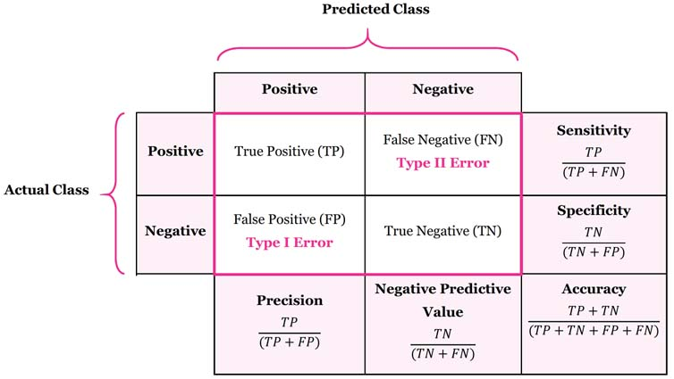
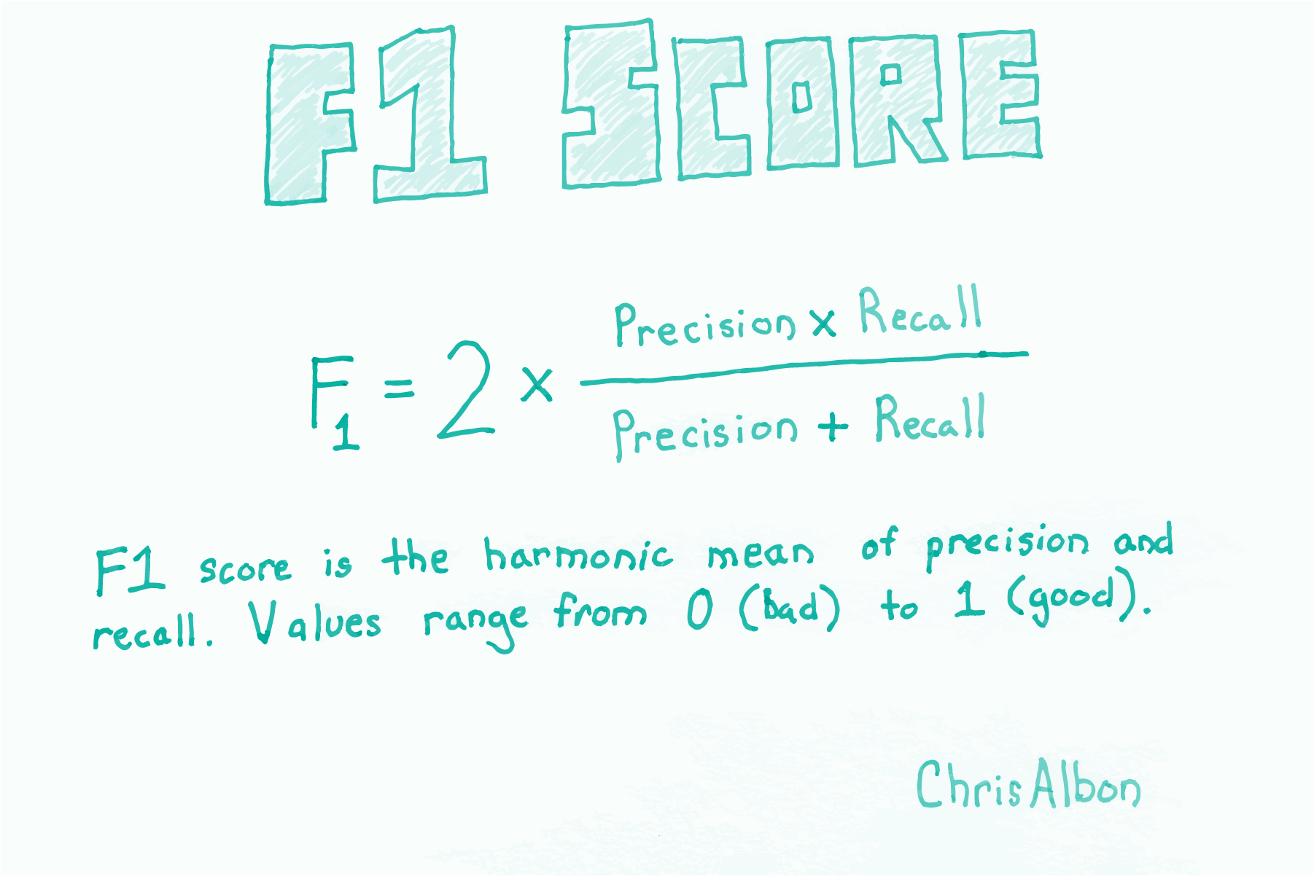
Machine Learning Model
Train-Test Split - Prerequisite of implementing model where data is splitted randomly into ratio of 7:3 for train data and test data respectively. Parameter ‘Seed’ = any number is passed to get reproducibility i.e same outcome on every run.
Models implemented are : 1. Logistic Regression 2. Random Forest 3.Gradient Boosted Tree Classifier.
Evaluation Metric used are: 1. Accuracy 2. F1 - score 3. Area Under ROC .
Accuracy, a metric which denotes the no. of cases correctly identified of the whole data, is used when target variable is balanced.
F1 score and AUC( True Positive Rate vs False Positive Rate Curve) is used when data is imbalanced.

Slide 12
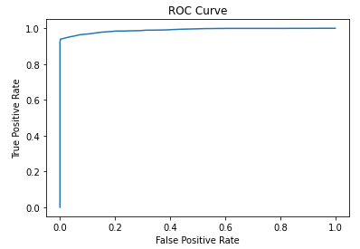
ML Model Evaluation
Model | Accuracy% | F1-score % | AUC %
Logistic Regression | 92.76 | 92.72 | 98.61
Random Forest | 81.31 | 81.30 | 89.55
GBT Classifier | 95.02 | 95.02 | 98.67
Hyper Parameter optimized and Cross Validated Gradient Boosted Tree classifier has an Accuracy: 96.11% ,F1_Score: 96.10% and Area under ROC Curve: 99.11 % .

Slide 13
Conclusion
The dataset has been best evaluated by GBT Classifier followed by Logistic Regression and Random Forest. As the dataset has been synthetically oversampled by SMOTE, there still lies a chance of overfitting of data as we do not have enough test sample to put it through.
But the model which previously with a imbalanced class was giving an AUC score of 0.83 (LR) improved dramatically after applying SMOTE , ParamGridBuilder and Crossvalidator with GBT classifier to give an AUC of 0.9961 which actually gives an idea of how well the model is segregating true negative from true positive without overlapping with each other and thus avoiding create ‘Type 1’ or ‘Type 2’ error. Also Gradient Boosting is a sequential process and thus every time it makes an incorrect prediction, it focuses more on that incorrectly predicted data point.
This model, in future, can be optimised and deployed to actually curb and detect cardiac arrest probability. Also with larger sample data, it may help in catching most important variables i.e factors for cardiac death and help us to reduce it to a great extent.

Slide 14

Questions??

